Slide 1
“KEGG analysis in health and disease”
Set of slides produced for John Earls
April 12, 2015
Dr. Larry Smarr
Director, California Institute for Telecommunications and Information Technology
Harry E. Gruber Professor,
Dept. of Computer Science and Engineering
Jacobs School of Engineering, UCSD
http://lsmarr.calit2.net

Slide 2



JCVI Sequenced My Gut Microbiome and We Downloaded ~270 More from the NIH Human Microbiome Project For Comparative Analysis
Each Sample Has 100-200 Million Illumina Short Reads (100 bases)
“Healthy” Individuals
Inflammatory Bowel Disease (IBD) Patients
250 Subjects
1 Point in Time
2 Ulcerative Colitis Patients,
6 Points in Time
Larry Smarr
(Colonic Crohn’s)
7 Points in Time
5 Ileal Crohn’s Patients, 3 Points in Time
Total of 27 Billion Reads
Or 2.7 Trillion Bases
Source: Jerry Sheehan, Calit2
Weizhong Li, Sitao Wu, CRBS, UCSD

Slide 3
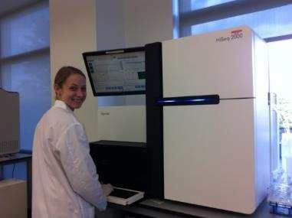
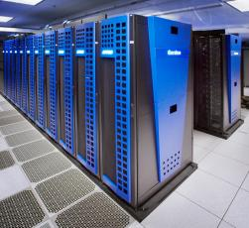







To Map Out the Dynamics of Autoimmune Microbiome Ecology Couples Next Generation Genome Sequencers to Big Data Supercomputers
Example: Inflammatory Bowel Disease (IBD)
Illumina HiSeq 2000 at JCVI
Metagenomic Sequencing
JCVI Produced
~150 Billion DNA Bases From Seven of LS Stool Samples Over 1.5 Years
We Downloaded ~3 Trillion DNA Bases From NIH Human Microbiome Program Data Base
255 Healthy People, 21 with IBD
Supercomputing (Weizhong Li, JCVI/HLI/UCSD):
~20 CPU-Years on SDSC’s Gordon
~4 CPU-Years on Dell’s HPC Cloud
Produced Relative Abundance of
~10,000 Bacteria, Archaea, Viruses in ~300 People
~3Million Filled Spreadsheet Cells
SDSC Gordon Data Supercomputer

Slide 4

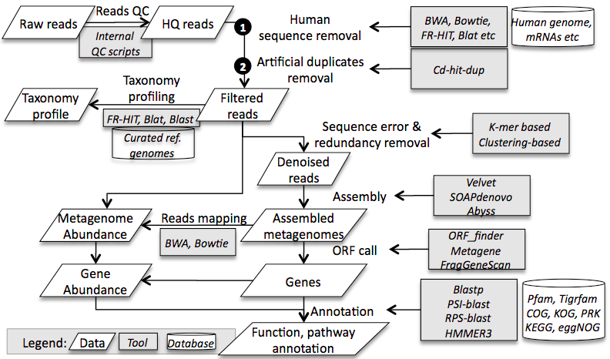



Computational NextGen Sequencing Pipeline: From Sequence to Taxonomy and Function
PI: (Weizhong Li, CRBS, UCSD):
NIH R01HG005978 (2010-2013, $1.1M)

Slide 5
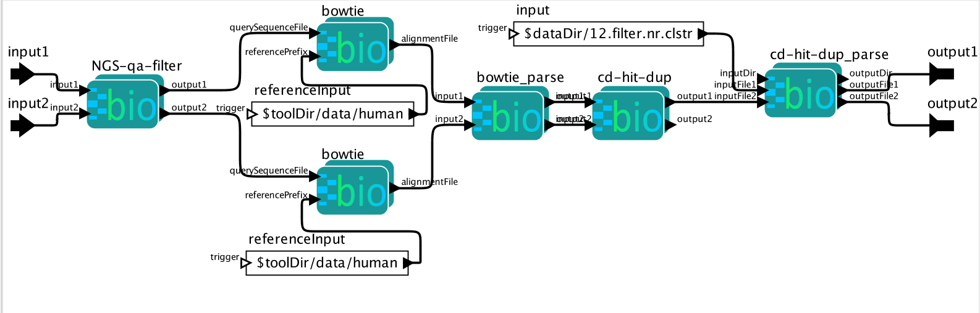
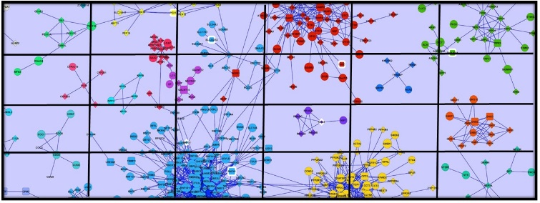

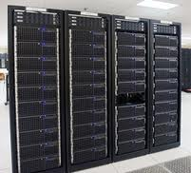
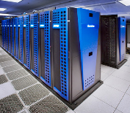







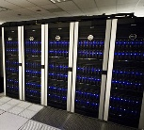
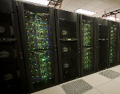




Next Step Programmability, Scalability and Reproducibility using bioKepler
www.biokepler.org
Optimized
Source: Ilkay Altintas, SDSC
Local Cluster Resources
Cloud
Resources
National Resources
(Gordon)
(Comet)
(Lonestar)
(Stampede)
www.kepler-project.org

Slide 6
How Best to Analyze The Microbiome Datasets to Discover Patterns in Health and Disease?
Can We Find New Noninvasive Diagnostics
In Microbiome Ecologies?

Slide 7
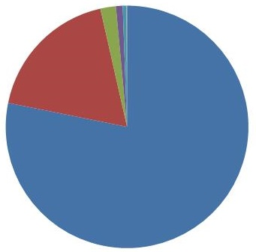
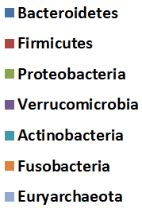
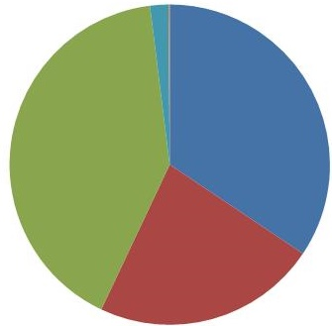
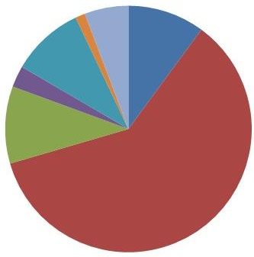
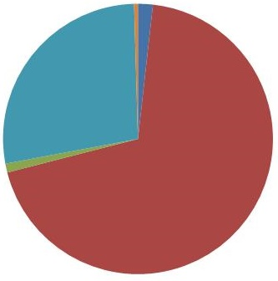
We Found Major State Shifts in Microbial Ecology Phyla Between Healthy and Two Forms of IBD
Average Healthy
Most
Common
Microbial
Phyla
Average Ulcerative Colitis
Average Colonic Crohn’s Disease
Average Ileal Crohn’s Disease
Explosion of
Proteobacteria
Hybrid of UC and CD
High Level of Archaea
Collapse of Bacteroidetes
Explosion of Actinobacteria

Slide 8
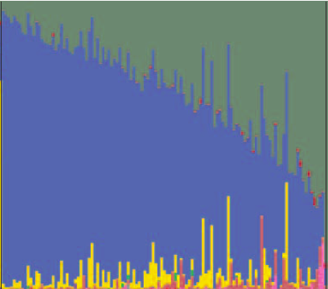
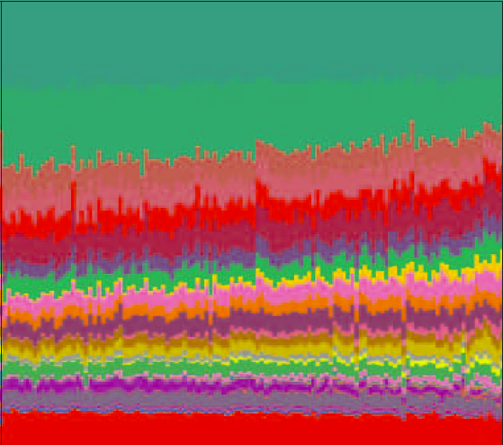
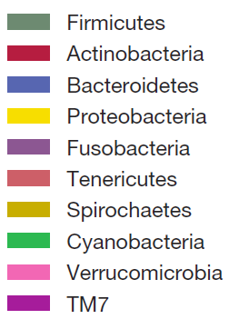
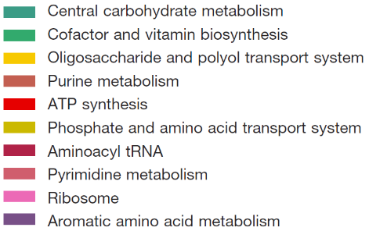
In a “Healthy” Gut Microbiome: Large Taxonomy Variation, Low Protein Family Variation
Over 200 People
Source: Nature, 486, 207-212 (2012)

Slide 9
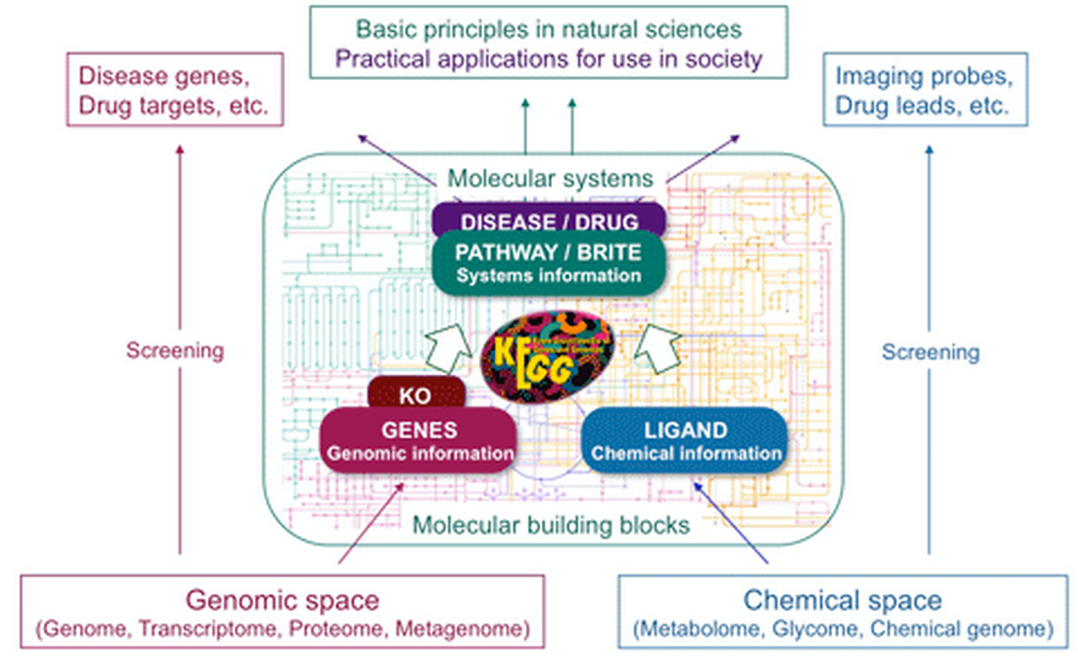
KEGG: a Database Resource for Understanding High-Level Functions and Utilities of the Biological System
http://www.genome.jp/kegg/

Slide 10
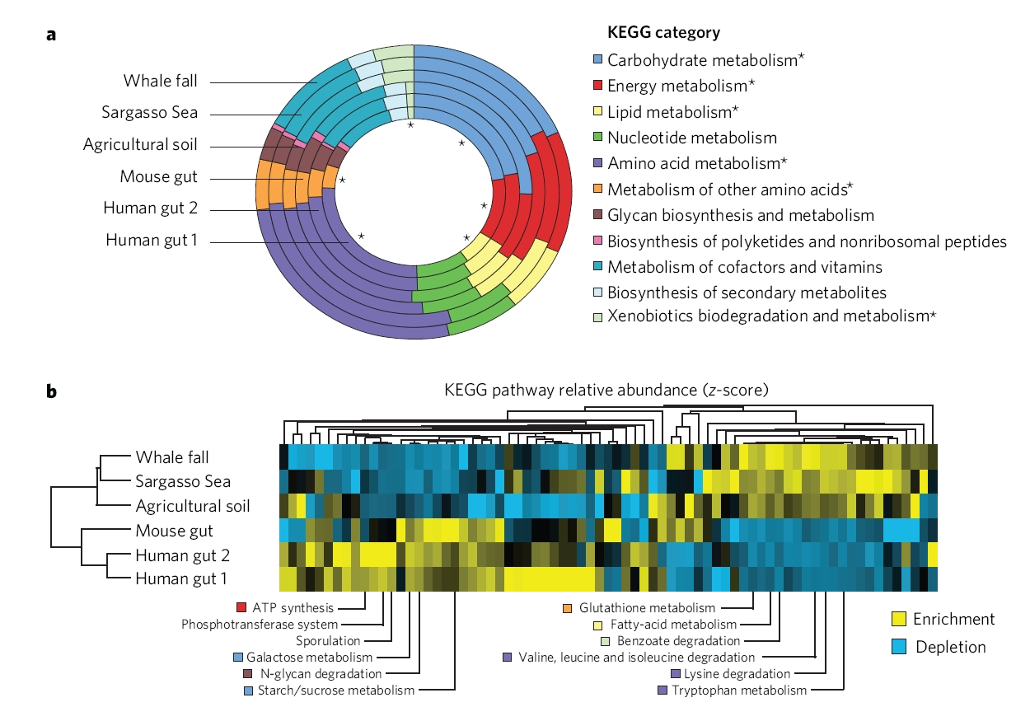
Using KEGGs to Explore Human Gut Functional Capabilities
www.nature.com/scitable/content/functional-comparison-of-the-gut-microbiome-with-24385
Source: Adams, J. (2008) Simple viral and bacterial genomes. Nature Education 1(1):185

Slide 11
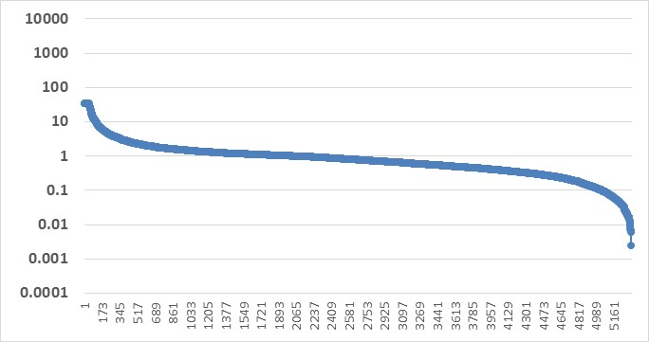
Ratio of HE11529 to Ave HE Test to see How Much Variation There is Within Healthy
Ratio of Random HE11529 to Healthy Average for Each Nonzero KEGG
Similar to HMP Healthy Results
Most KEGGs Are Within 10x
Of Healthy for a Random HE

Slide 12
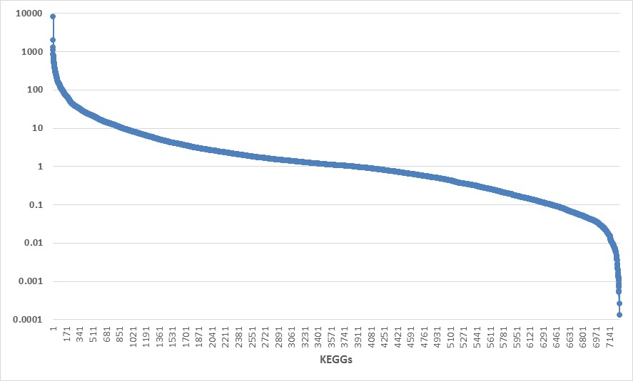
However, Our Research Shows Large Changes in Protein Families Between Health and Disease – Ileal Crohns
Ratio of CD Average to Healthy Average for Each Nonzero KEGG
KEGGs Greatly Increased
In the Disease State
Note Hi/Low
Symmetry
Most KEGGs Are Within 10x
In Healthy and Ileal Crohn’s Disease
KEGGs Greatly Decreased
In the Disease State
Over 7000 KEGGs Which Are Nonzero in Health and Disease States

Slide 13
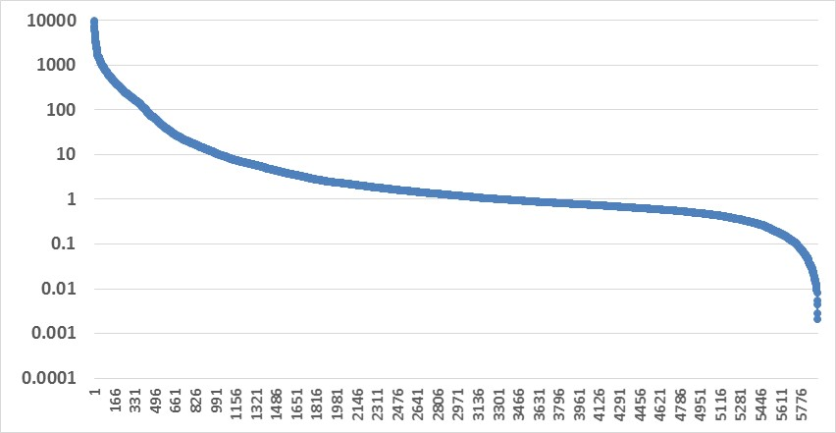
Note Ulcerative Colitis Has Few KEGGs that are Much Smaller than HE; Note Asymmetry Between High & Low
Ratio of UC Average to Healthy Average for Each Nonzero KEGG
Note Hi/Low
Asymmetry
KEGGs Greatly Increased
In the Disease State
Most KEGGs Are Within 10x
In Healthy and Ulcerative Colitis
KEGGs Greatly Decreased
In the Disease State

Slide 14
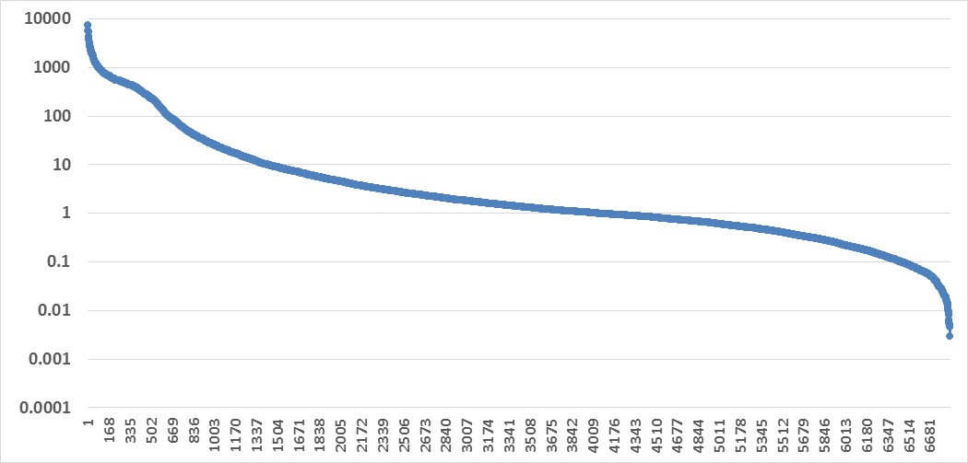
Note LS001 Has Few KEGGs that are Much Smaller than HE; But Many More (1337) That are >10x HE Than CD (~700) or UC (~900)
Ratio of LS001 Average to Healthy Average for Each Nonzero KEGG
KEGGs Greatly Increased
In the Disease State
Most KEGGs Are Within 10x
In Healthy and LS001
KEGGs Greatly Decreased
In the Disease State

Slide 15
Sick Healthy Person 16585
Note: Major Reduction in
Total Gene Families
KEGGs Within 10x
In Healthy and LS001

Slide 16
We Can Define a Subgroup of the 10,000 KEGGs Which Are Extreme in the Disease State?
Look for KEGGs That Have the Properties:
Are 100x in All Four Disease States
LS001/Ave HE
Ave CD/ Ave HE
Ave UC/Ave HE
Sick HE Person/Ave HE
There are 48 of These Extreme KEGGs (see spreadsheet)
A New Way to Define What is Wrong with the Microbiome in Disease?

Slide 17
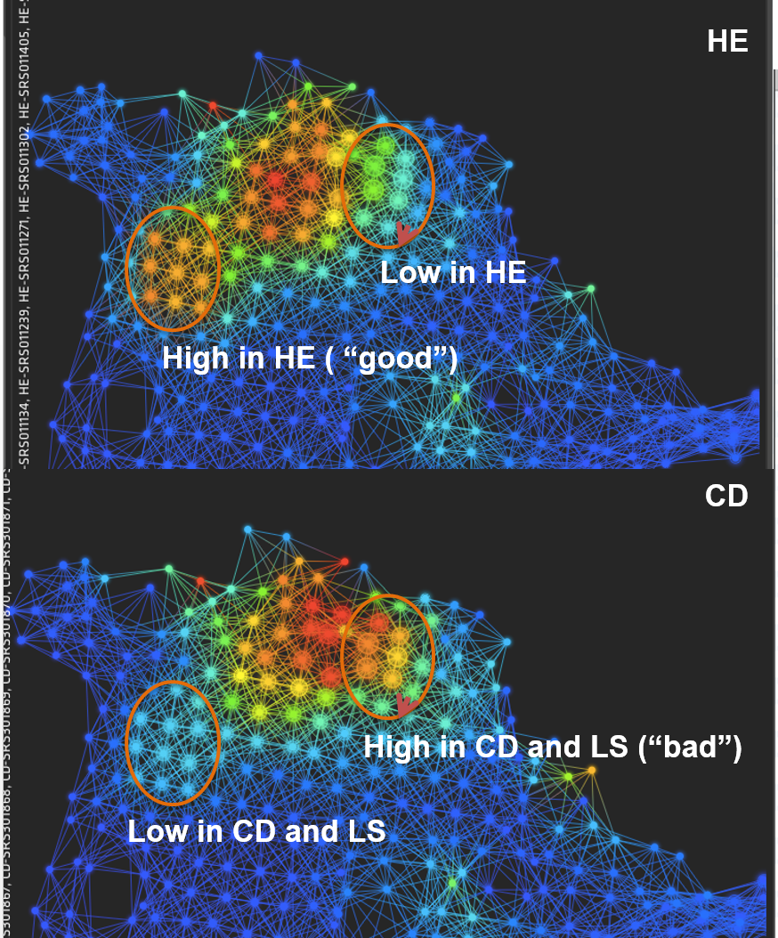
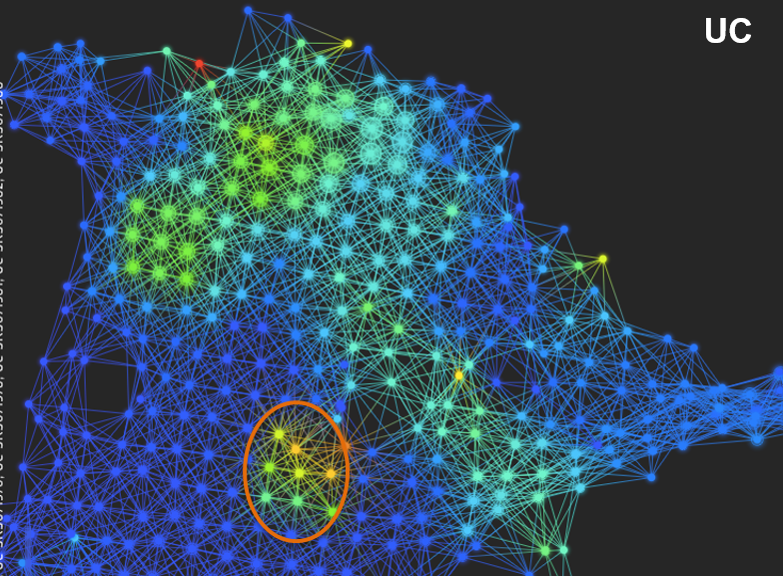

Using Ayasdi Interactively to Explore Protein Families in Healthy and Disease States
Dataset from Larry Smarr Team With 60 Subjects (HE, CD, UC, LS) Each with 10,000 KEGGs -
600,000 Cells
Source: Pek Lum, Formerly Chief Data Scientist, Ayasdi

Slide 18
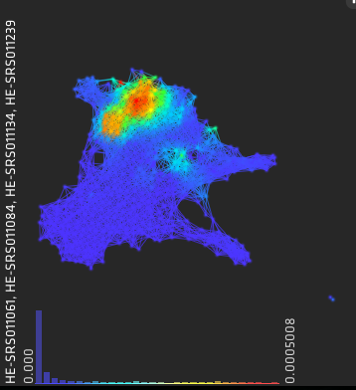
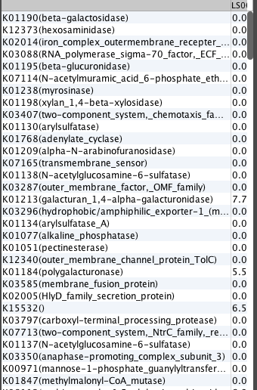
CD is Missing a Population of Bacteria That Exists in High Quantities in HE ( Circled with Arrow)
Low in CD and LS
Problem is That These KEGGs Have Moderate Values of Ave CD/ Ave HE
How Can We Change the Ayasdi Lenses So That We Pick Out The Very High Values of Ratios to Ave HE?
Source: Pek Lum, Formerly Chief Data Scientist, Ayasdi

Slide 19
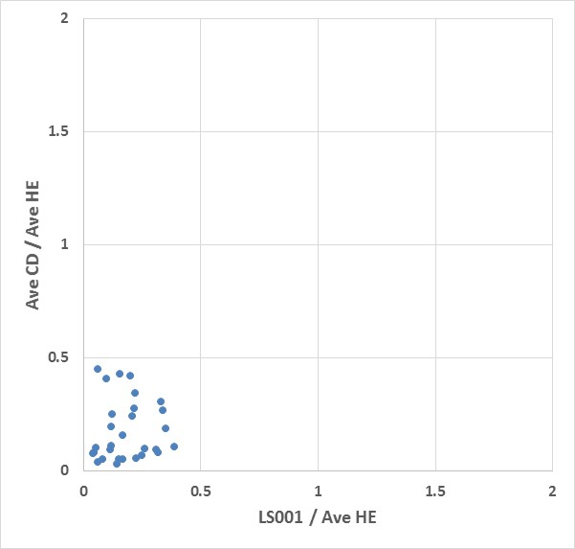
This Ayasdi Lens Does Identify KEGGs In Which Ave CD and LS001 Are Less Than Ave HE
Problem is That These KEGGs Have Moderate Low Values of Ave CD/ Ave HE
How Can We Change the Ayasdi Lenses So That We Pick Out The Very High Values of Ratios to Ave HE?

Slide 20
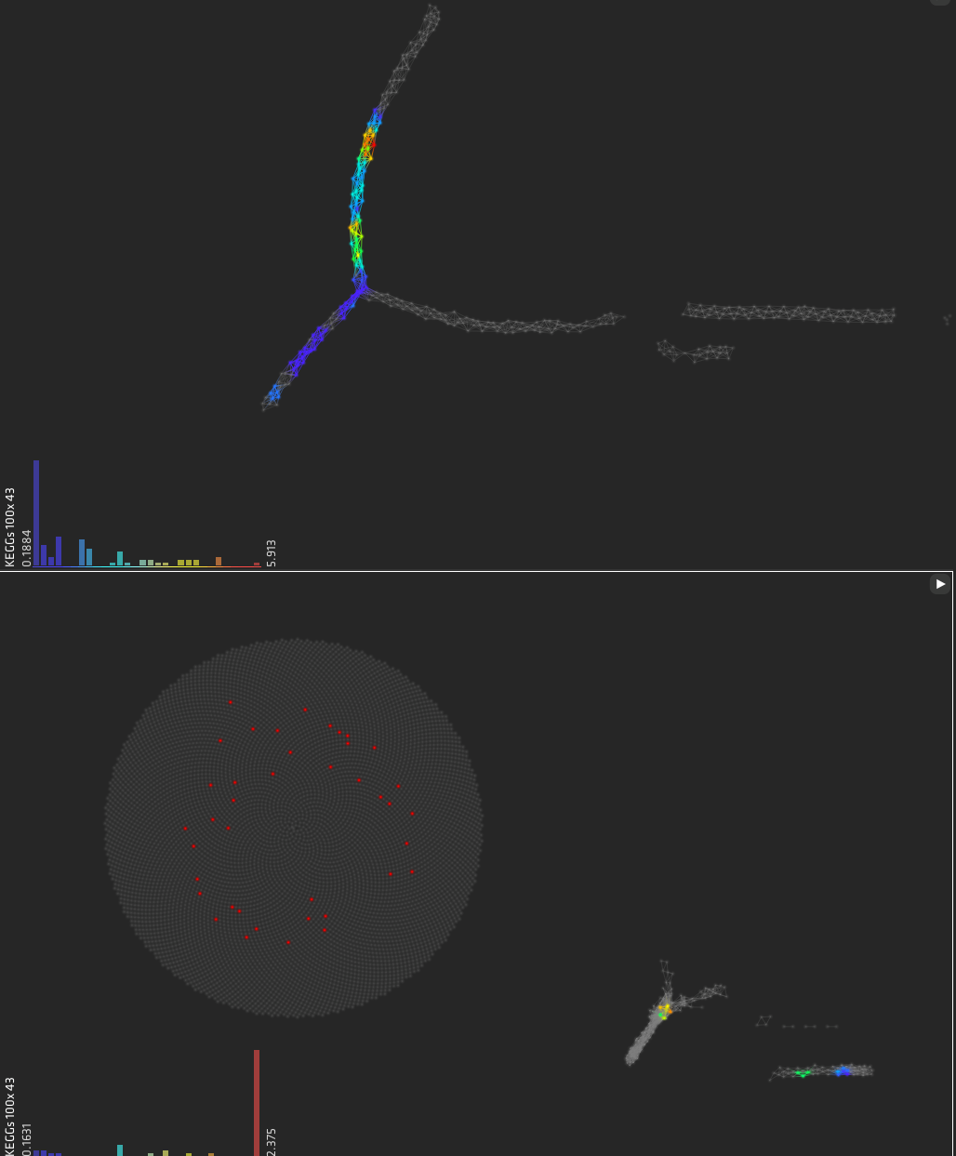
We Found a Set of Lenes That Clearer Find the 43 Extreme KEGGs
K00108(choline_dehydrogenase)
K00673(arginine_N-succinyltransferase)
K00867(type_I_pantothenate_kinase)
K01169(ribonuclease_I_(enterobacter_ribonuclease))
K01484(succinylarginine_dihydrolase)
K01682(aconitate_hydratase_2)
K01690(phosphogluconate_dehydratase)
K01825(3-hydroxyacyl-CoA_dehydrogenase_/_enoyl-CoA_hydratase_/3-hydroxybutyryl-CoA_epimerase_/_enoyl-CoA_isomerase_[EC:1.1.1.354.2.1.17_5.1.2.3_5.3.3.8])
K02173(hypothetical_protein)
K02317(DNA_replication_protein_DnaT)
K02466(glucitol_operon_activator_protein)
K02846(N-methyl-L-tryptophan_oxidase)
K03081(3-dehydro-L-gulonate-6-phosphate_decarboxylase)
K03119(taurine_dioxygenase)
K03181(chorismate--pyruvate_lyase)
K03807(AmpE_protein)
K05522(endonuclease_VIII)
K05775(maltose_operon_periplasmic_protein)
K05812(conserved_hypothetical_protein)
K05997(Fe-S_cluster_assembly_protein_SufA)
K06073(vitamin_B12_transport_system_permease_protein)
K06205(MioC_protein)
K06445(acyl-CoA_dehydrogenase)
K06447(succinylglutamic_semialdehyde_dehydrogenase)
K07229(TrkA_domain_protein)
K07232(cation_transport_protein_ChaC)
K07312(putative_dimethyl_sulfoxide_reductase_subunit_YnfH_(DMSO_reductaseanchor_subunit))
K07336(PKHD-type_hydroxylase)
K08989(putative_membrane_protein)
K09018(putative_monooxygenase_RutA)
K09456(putative_acyl-CoA_dehydrogenase)
K09998(arginine_transport_system_permease_protein)
K10748(DNA_replication_terminus_site-binding_protein)
K11209(GST-like_protein)
K11391(ribosomal_RNA_large_subunit_methyltransferase_G)
K11734(aromatic_amino_acid_transport_protein_AroP)
K11735(GABA_permease)
K11925(SgrR_family_transcriptional_regulator)
K12288(pilus_assembly_protein_HofM)
K13255(ferric_iron_reductase_protein_FhuF)
K14588()
K15733()
K15834()
L-Infinity Centrality Lens Using Norm Correlation
as Metric (Resolution: 242, Gain: 5.7)
Entropy & Variance Lens
Using Angle as Metric (Resolution: 30, Gain 3.00)
Analysis by Mehrdad Yazdani, Calit2

Slide 21
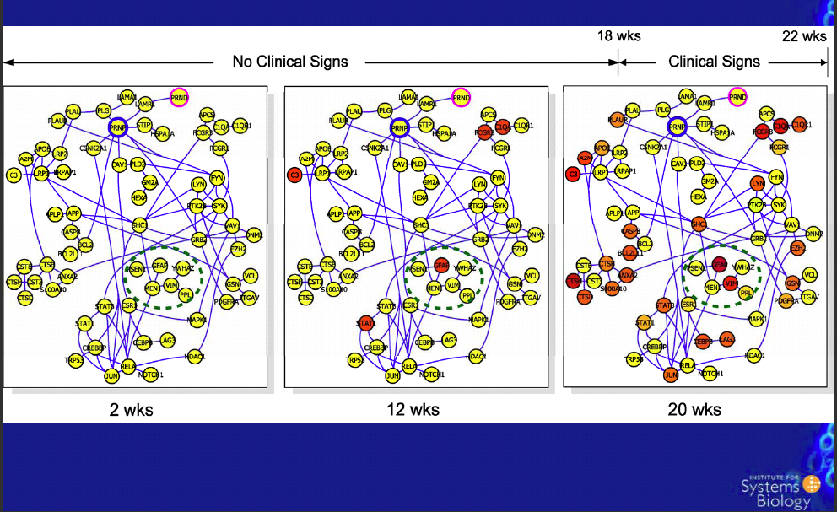
Disease Arises from Perturbed Protein Family Networks: Dynamics of a Prion Perturbed Network in Mice
Source: Lee Hood, ISB
Our Next Goal is to Create
Such Perturbed Networks in Humans

Slide 22
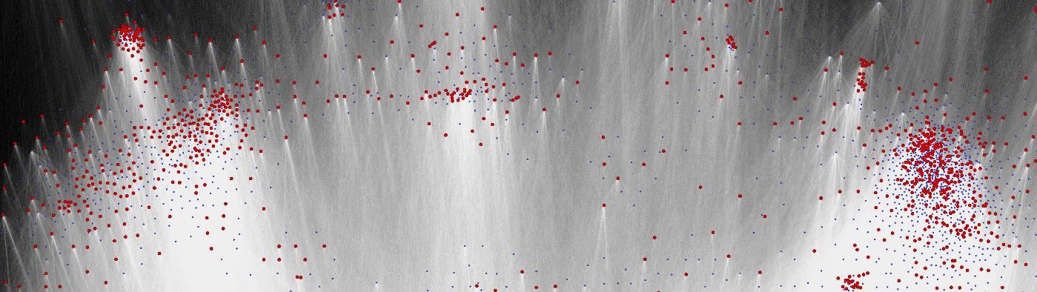

Calit2’s Qualcomm Institute Has Developed Interactive Scalable Visualization for Biological Networks
Runs Native on 64Million Pixels
20,000 Samples
60,000 OTUs
18 Million Edges

